Slide 1
SYNTAX ANALYSIS
OR
PARSING
Lecture 05

Slide 2
TOP DOWN PARSING
Find a left-most derivation
Find (build) a parse tree
Start building from the root and work down…
As we search for a derivation
  Must make choices:
    Which rule to use
    Where to use it
May run into problems!!

Slide 3
TOP-DOWN PARSING
Recursive-Descent Parsing
    Backtracking is needed (If a choice of a production rule does not work, we backtrack to try other alternatives.)
    It is a general parsing technique, but not widely used.
    Not efficient
Predictive Parsing
    no backtracking
    efficient
    needs a special form of grammars (LL(1) grammars).
    Recursive Predictive Parsing is a special form of Recursive Descent parsing without backtracking.
    Non-Recursive (Table Driven) Predictive Parser is also known as LL(1) parser.

Slide 4
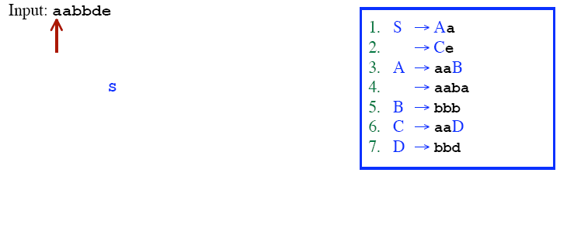
RECURSIVE DESCENT PARSING (BACKTRACKING)

Slide 5
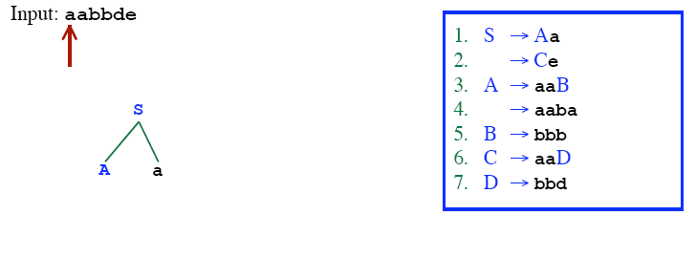
RECURSIVE DESCENT PARSING (BACKTRACKING)

Slide 6
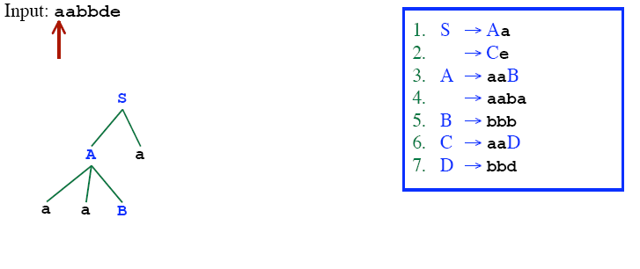
RECURSIVE DESCENT PARSING (BACKTRACKING)

Slide 7
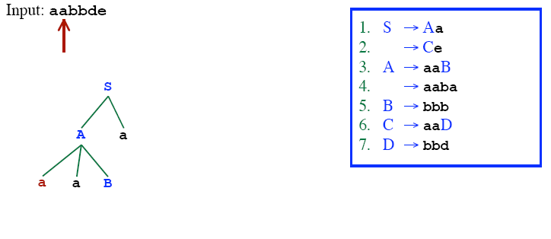
RECURSIVE DESCENT PARSING (BACKTRACKING)

Slide 8
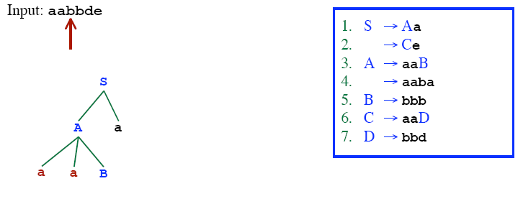
RECURSIVE DESCENT PARSING (BACKTRACKING)

Slide 9
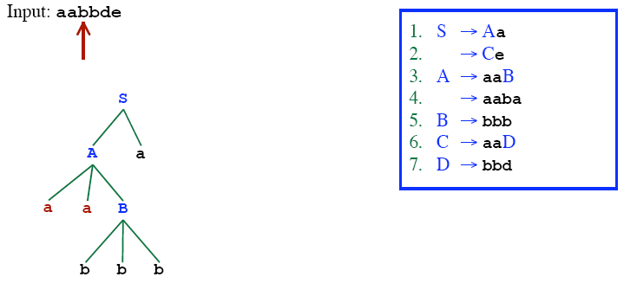
RECURSIVE DESCENT PARSING (BACKTRACKING)

Slide 10
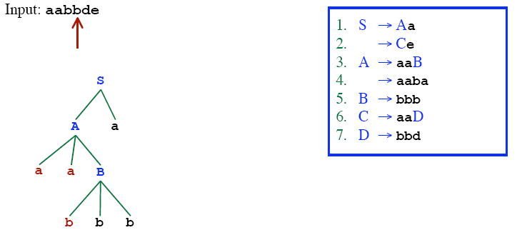
RECURSIVE DESCENT PARSING (BACKTRACKING)

Slide 11
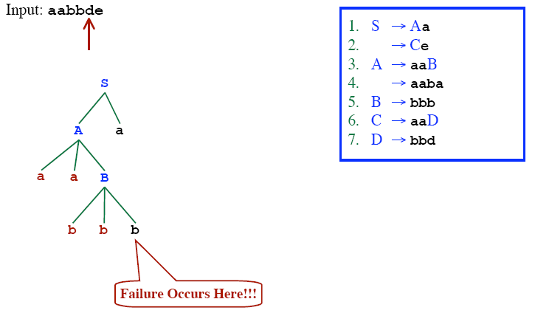
RECURSIVE DESCENT PARSING (BACKTRACKING)

Slide 12
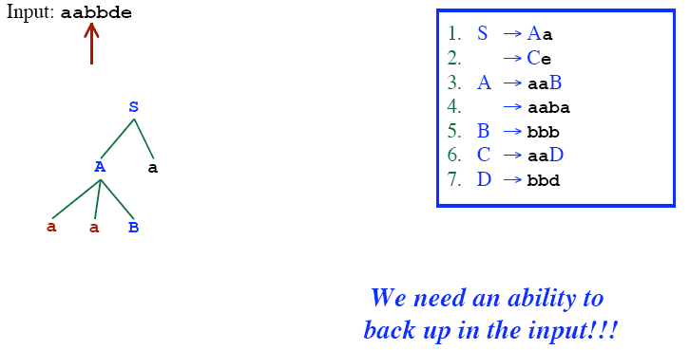
RECURSIVE DESCENT PARSING (BACKTRACKING)

Slide 13
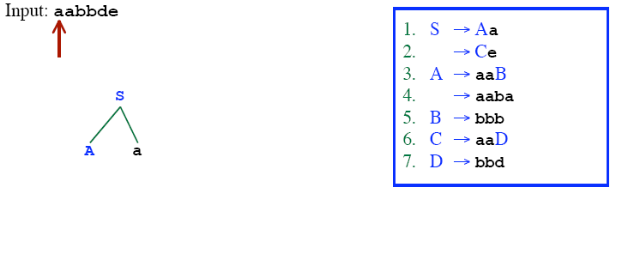
RECURSIVE DESCENT PARSING (BACKTRACKING)

Slide 14
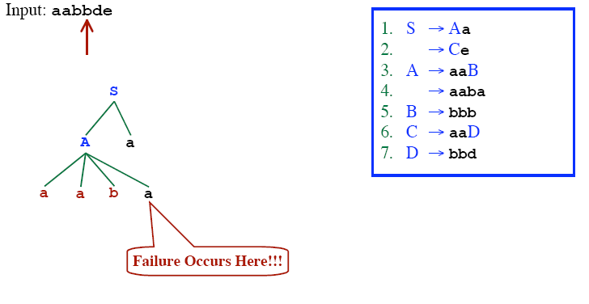
RECURSIVE DESCENT PARSING (BACKTRACKING)

Slide 15
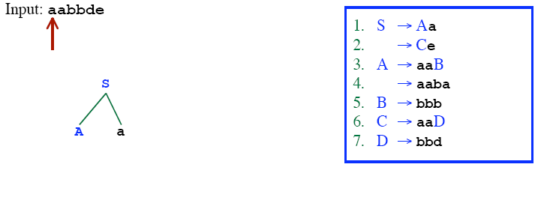
RECURSIVE DESCENT PARSING (BACKTRACKING)

Slide 16
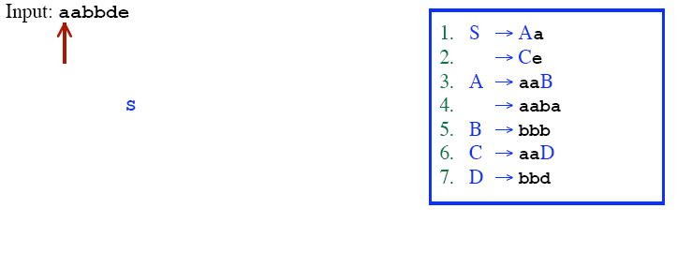
RECURSIVE DESCENT PARSING (BACKTRACKING)

Slide 17
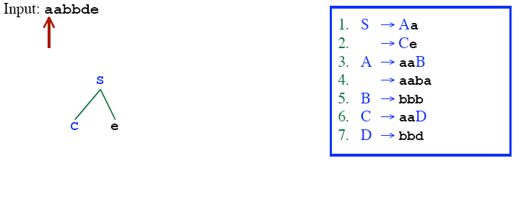
RECURSIVE DESCENT PARSING (BACKTRACKING)

Slide 18
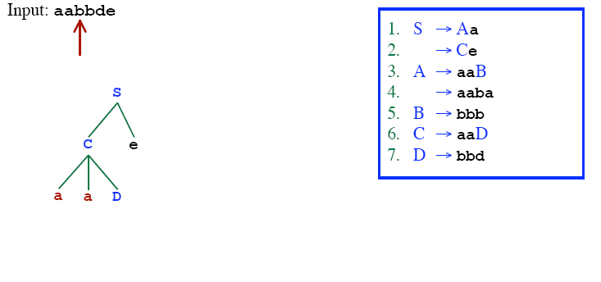
RECURSIVE DESCENT PARSING (BACKTRACKING)

Slide 19
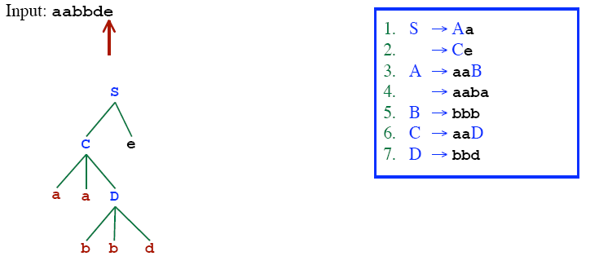
RECURSIVE DESCENT PARSING (BACKTRACKING)

Slide 20
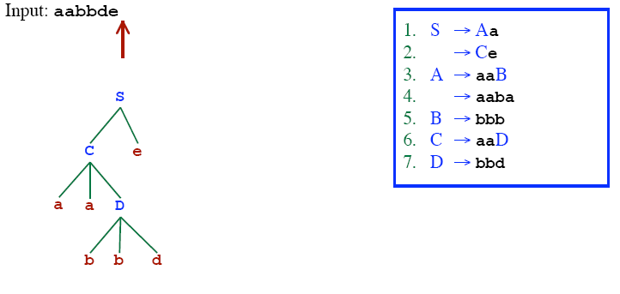
RECURSIVE DESCENT PARSING (BACKTRACKING)
Successfully parsed!!

Slide 21
RECURSIVE-DESCENT PARSING ALGORITHM
A recursive-descent parsing program consists of a set of procedures – one for each non-terminal
Execution begins with the procedure for the start symbol
  Announces success if the procedure body scans the entire input
void A(){
for (j=1 to t){ /* assume there is t number of A-productions */
Choose a A-production, A_{j}→X₁X₂…X_{k};
for (i=1 to k){
if (X_{i} is a non-terminal)
call procedure X_{i}();
else if (X_{i} equals the current input symbol a)
advance the input to the next symbol;
else backtrack in input and reset the pointer
}
}
}

Slide 22
PREDICTIVE PARSER
When re-writing a non-terminal in a derivation step, a predictive parser can uniquely choose a production rule by just looking the current symbol in the input string.
A → α₁ | ... | α_{n} input: ... a .......
current token

Slide 23
PREDICTIVE PARSER (EXAMPLE)
stmt → if ...... |
while ...... |
begin ...... |
for .....
When we are trying to write the non-terminal stmt, if the current token is if we have to choose first production rule.
When we are trying to write the non-terminal stmt, we can uniquely choose the production rule by just looking the current token.
We eliminate the left recursion in the grammar, and left factor it. But it may not be suitable for predictive parsing (not LL(1) grammar).

Slide 24
RECURSIVE PREDICTIVE PARSING
Each non-terminal corresponds to a procedure.
Ex: A → aBb (This is only the production rule for A)
proc A {
- match the current token with a, and move to the next token;
- call ‘B’;
- match the current token with b, and move to the next token;
}

Slide 25
RECURSIVE PREDICTIVE PARSING (CONT.)
A → aBb | bAB
proc A {
case of the current token {
‘a’: - match the current token with a, and move to the next token;
- call ‘B’;
- match the current token with b, and move to the next token;
‘b’: - match the current token with b, and move to the next token;
- call ‘A’;
- call ‘B’;
}
}

Slide 26
RECURSIVE PREDICTIVE PARSING (CONT.)
When to apply ε-productions.
A → aA | bB | ε
If all other productions fail, we should apply an ε-production. For example, if the current token is not a or b, we may apply the ε-production.
Most correct choice: We should apply an ε-production for a non-terminal A when the current token is in the follow set of A (which terminals can follow A in the sentential forms).

Slide 27
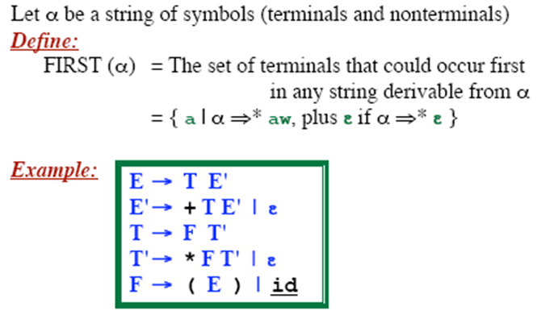
FIRST FUNCTION
FIRST (E) =
FIRST (E’) =
FIRST (T) =
FIRST (T’) =
FIRST (F) =

Slide 28
FIRST - EXAMPLE
P → i | c | n T S
Q → P | a S | b S c S T
R → b | ε
S → c | R n | ε
T → R S q
FIRST(P) =
FIRST(Q) =
FIRST(R) =
FIRST(S) =
FIRST(T) =

Slide 29
FIRST - EXAMPLE
P → i | c | n T S
Q → P | a S | b S c S T
R → b | ε
S → c | R n | ε
T → R S q
FIRST(P) = {i,c,n}
FIRST(Q) = {i,c,n,a,b}
FIRST(R) = {b,ε}
FIRST(S) = {c,b,n,ε}
FIRST(T) = {b,c,n,q}

Slide 30
FIRST - EXAMPLE
S → a S e | S T S
T → R S e | Q
R → r S r | ε
Q → S T | ε
FIRST(S) =
FIRST(R) =
FIRST(T) =
FIRST(Q) =

Slide 31
FIRST - EXAMPLE
S → a S e | S T S
T → R S e | Q
R → r S r | ε
Q → S T | ε
FIRST(S) = {a}
FIRST(R) = {r, ε}
FIRST(T) = {r, a, ε}
FIRST(Q) = {a, ε}

Slide 32
FOLLOW SETS
FOLLOW(A) is the set of terminals (including end marker of input - $) that may follow non-terminal A in some sentential form.
FOLLOW(A) = {c | S ⇒⁺ …Ac…} ∪ {$} if S ⇒⁺ …A
For example, consider L ⇒⁺ (())(L)L
  Both ‘)’ and end of file can follow L
NOTE: ε is never in FOLLOW sets

Slide 33
COMPUTING FOLLOW(A)
If A is start symbol, put $ in FOLLOW(A)
Productions of the form B → α A β,
  Add FIRST(β) – {ε} to FOLLOW(A)
Productions of the form B → α A or
B → α A β where β ⇒* ε
  Add FOLLOW(B) to FOLLOW(A)

Slide 34
EXAMPLE
FOLLOW(E) = {$}
FOLLOW(E′) =
FOLLOW(T) =
FOLLOW(T′) =
FOLLOW(F) =
E → T E′
E′ → + T E′ | ε
T → F T′
T′ → * F T′ | ε
F → ( E ) | id
FIRST(E) = {(, id}
FIRST(E′) = {+, ε}
FIRST(T) = {(, id}
FIRST(T′) = {*, ε}
FIRST(F) = {(, id}}
Using rule #1
If A is start symbol, put $ in FOLLOW(A)
Assume the first non-terminal is the start symbol

Slide 35
EXAMPLE
E → T E′
E′ → + T E′ | ε
T → F T′
T′ → * F T′ | ε
F → ( E ) | id
FIRST(E) = {(, id}
FIRST(E′) = {+, ε}
FIRST(T) = {(, id}
FIRST(T′) = {*, ε}
FIRST(F) = {(, id}}
FOLLOW(E) = {$, )}
FOLLOW(E′) =
FOLLOW(T) = {+}
FOLLOW(T′) =
FOLLOW(F) = {*}
Using rule #2
Productions of the form B → α A β,
  Add FIRST(β) – {ε} to FOLLOW(A)

Slide 36
EXAMPLE
E → T E′
E′ → + T E′ | ε
T → F T′
T′ → * F T′ | ε
F → ( E ) | id
FIRST(E) = {(, id}
FIRST(E′) = {+, ε}
FIRST(T) = {(, id}
FIRST(T′) = {*, ε}
FIRST(F) = {(, id}}
FOLLOW(E) = {$, )}
FOLLOW(E′) = FOLLOW(E)
  = {$, )}
FOLLOW(T) = {+} ∪ FOLLOW(E′)
= {+, $, )}
FOLLOW(T′) = FOLLOW(T)
= {+, $, )}
FOLLOW(F) = {*} ∪ FOLLOW(T′)
= {*, +, $, )}
Using rule #3
Productions of the form B → α A or
B → α A β where β ⇒* ε
  Add FOLLOW(B) to FOLLOW(A)

Slide 37
EXAMPLE
S → ( A) | ε
A → T E
E → & T E | ε
T → ( A ) | a | b | c
  FIRST(T) =
  FIRST(E) =
  FIRST(A) =
  FIRST(S) =
    FOLLOW(S) =
    FOLLOW(A) =
    FOLLOW(E) =
    FOLLOW(T) =

Slide 38
EXAMPLE
S → ( A) | ε
A → T E
E → & T E | ε
T → ( A ) | a | b | c
FIRST(T) = {(,a,b,c}
FIRST(E) = {&, ε }
FIRST(A) = {(,a,b,c}
FIRST(S) = {(, ε}
FOLLOW(S) = {$}
FOLLOW(A) = { ) }
FOLLOW(E) = FOLLOW(A) = { ) }
FOLLOW(T) = FIRST(E) ∪ FOLLOW(E) = {&, )}

Slide 39
EXAMPLE
S → a S e | B
B → b B C f | C
C → c C g | d | ε
FIRST(C) =
FIRST(B) =
FIRST(S) =
FOLLOW(C) =
FOLLOW(B) =
FOLLOW(S) = {$}
Assume the first non-terminal is the start symbol
If A is start symbol, put $ in FOLLOW(A)
2. Productions of the form B → α A β,
  Add FIRST(β) – {ε} to FOLLOW(A)
Productions of the form B → α A or
B → α A β where β ⇒* ε
  Add FOLLOW(B) to FOLLOW(A)

Slide 40
EXAMPLE
S → a S e | B
B → b B C f | C
C → c C g | d | ε
FIRST(C) = {c,d,ε}
FIRST(B) = {b,c,d,ε}
FIRST(S) = {a,b,c,d,ε}
FOLLOW(C) =
FOLLOW(B) =
FOLLOW(S) = { }
_{{f,g} ∪ FOLLOW(B)}
_{= {c,d,e,f,g,$}}
_{{c,d} ∪ FOLLOW(S)}
_{= {c,d,e,$}}
_{$, e}

Slide 41
FOLLOW EXAMPLE
S → a S e | B
B → b B C f | C
C → c C g | d | ε
FIRST(C) =
FIRST(B) =
FIRST(S) =
FOLLOW(C) =
FOLLOW(B) =
FOLLOW(S) = {$}
Assume the first non-terminal is the start symbol
If A is start symbol, put $ in FOLLOW(A)
2. Productions of the form B → α A β,
  Add FIRST(β) – {ε} to FOLLOW(A)
Productions of the form B → α A or
B → α A β where β ⇒* ε
  Add FOLLOW(B) to FOLLOW(A)

Slide 42
FOLLOW EXAMPLE
S → a S e | B
B → b B C f | C
C → c C g | d | ε
FIRST(C) = {c,d,ε}
FIRST(B) = {b,c,d,ε}
FIRST(S) = {a,b,c,d,ε}
FOLLOW(C) =
FOLLOW(B) =
FOLLOW(S) = { }
_{{f,g} ∪ FOLLOW(B)}
_{= {c,d,e,f,g,$}}
_{{c,d} ∪ FOLLOW(S)}
_{= {c,d,e,$}}
_{$, e}

Slide 43
PREDICTIVE PARSING
LL(1) Grammars
  Can do predictive parsing
  Can select the right rule
  Looking at only the next 1 input symbol
    First L : Left to Right Scanning
    Second L: Leftmost derivation
    1 : one input symbol look-ahead for predictive decision
LL(k) Grammars
  Can do predictive parsing
  Can select the right rule
  Looking at only the next k input symbols
Techniques to modify the grammar:
  Left Factoring
  Removal of Left Recursion
LL(k) Language
  Can be described with an LL(k) grammar

Slide 44
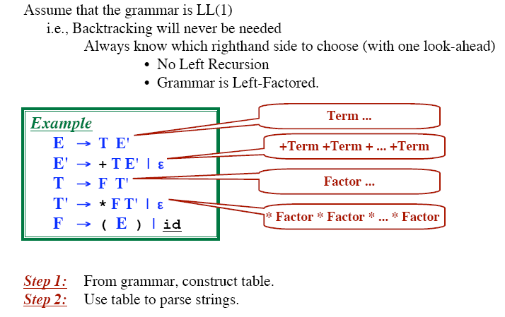
TABLE DRIVEN PREDICTIVE PARSING

Slide 45
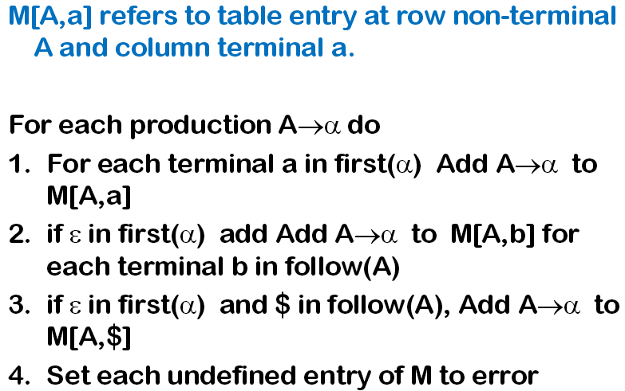
PARSE TABLE CONSTRUCTION

Slide 46
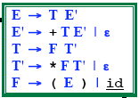
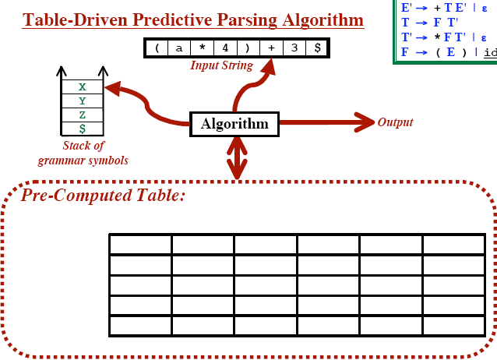
TABLE DRIVEN PREDICTIVE PARSING

Slide 47
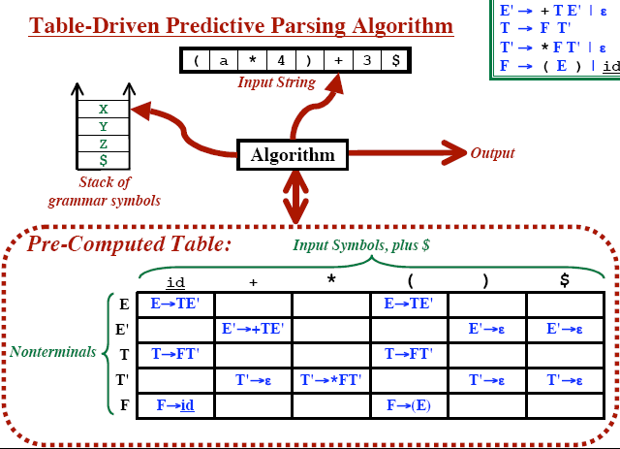
TABLE DRIVEN PREDICTIVE PARSING

Slide 48
QUESTIONS ?

